Slide 1
Design a bad sort algorithm!
What is the time complexity?

Slide 2
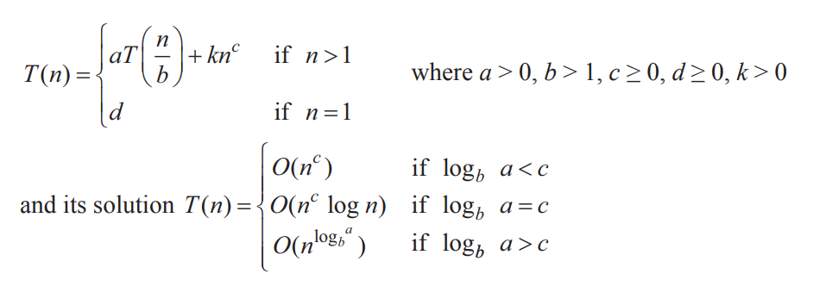
The Master Theorem

Slide 3

The Master Theorem
Use the master theorem to determine the time complexity of algorithms that have the following recurrence relations:
Notes:
O(n²)
O(n²logn)

